Slide 1
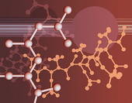
KIMIA KEJURUTERAAN
“Kimia kejuteraan merupakan kombinasi subjek kimia,fizik,matematik dan kejuruteraan . Adalah subjek wajib bagi pelajar jurusan teknikal. Mempunyai pemberat 5 jam kredit dengan pembahagian 3 jam kuliah, 2 jam amali dan 1 jam tutorial dalam seminggu. “

Slide 2
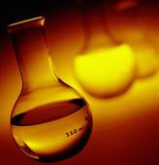
RINGKASAN KURSUS
SEMESTER I (TKO15)
SEMESTER 2 (TKO25)
BAB 1: MATTER
BAB 7: IONIC EQUILIBRIA
BAB 2: ATOMIC STRUCTURE
BAB 8: THERMOCHEMISTRY
BAB 3: PERIODIC TABLE
BAB 9: ELECTROCHEMISTRY
BAB 4: CHEMICAL BONDING
BAB 10: REACTION KINETIC
BAB 5: STATES OF MATTER
BAB 11: ORGANIC CHEMISTRY
BAB 6: CHEMICAL EQUILIBRIUM
BAB 12: HYDROCARBON
BAB 13: POLYMER

Slide 3
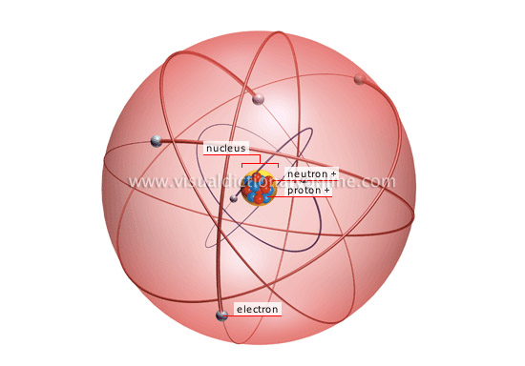
1)MATTER
1.1: Introduction to chemistry
1.2: Atoms and molecules
1.3: Mole concept
1.4: Concentration unit
1.5: Stoichiometry
A common way of defining matter is as anything that has mass and occupies volume. All objects are made from molecules , and molecules consist of atoms, which in turn consist of interacting subatomic particles like protons and electrons.

Slide 4
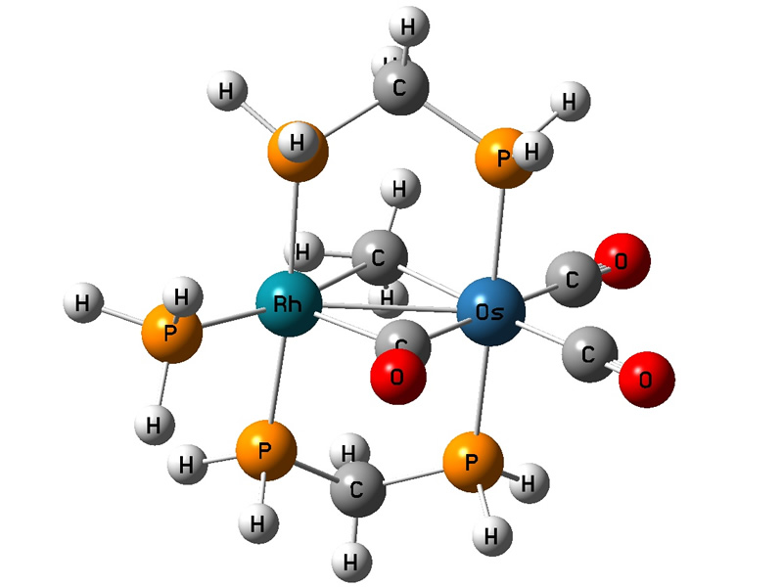
2)Atomic structure
2.1: Bohr’s atomic model
2.2: Quantum mechanical model
2.3: Electronic configuration
The electrons orbit the nucleus in strange lobes and spheres, and describe the probability of the electron being in a certain place more than they describe an orbit such as a planet

Slide 5
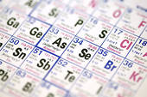
The periodic table is a tabular arrangement of the chemical elements by increasing atomic number which displays the elements so that one may see trends in their properties.
The periodic table is a tabular arrangement of the chemical elements by increasing atomic number which displays the elements so that one may see trends in their properties.
The periodic table is a tabular arrangement of the chemical elements by increasing atomic number which displays the elements so that one may see trends in their properties.
The periodic table is a tabular arrangement of the chemical elements by increasing atomic number which displays the elements so that one may see trends in their properties.
The periodic table is a tabular arrangement of the chemical elements by increasing atomic number which displays the elements so that one may see trends in their properties.
The periodic table is a tabular arrangement of the chemical elements by increasing atomic number which displays the elements so that one may see trends in their properties.
3)PERIODIC TABLE
3.1: Classification of elements
3.2: Periodicity
The periodic table is a tabular arrangement of the chemical elements by increasing atomic number which displays the elements so that one may see trends in their properties.

Slide 6
4)CHEMICAL BONDING
4.1: Lewis structure
4.2: Molecular shape and polarity
4.3: Intermolecular forces
4.4: Metallic bond
There is a chemical bond between two atoms or groups of atoms when the forces acting between them are strong enough to lead to the formation of an aggregate with sufficient stability to be regarded as an independent species. The number of bonds an atom forms corresponds to its valence.

Slide 7
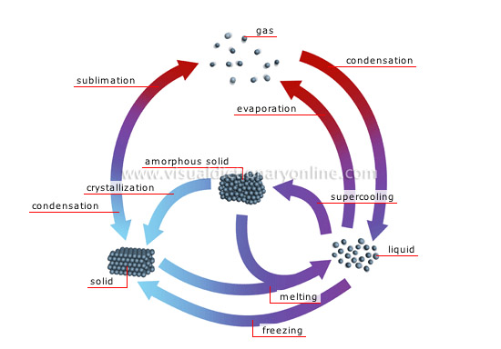
5)STATES OF MATTER
5.1: Gas
5.2: Liquid
5.3: Solid
The state or phase of a given set of matter can change depending on pressure and temperature conditions, transitioning to other phases as these conditions change to favor their existence. In a gas, the molecules have enough kinetic energy so that the effect of intermolecular forces is small known as an ideal gas.

Slide 8
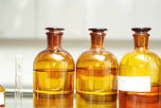
6)CHEMICAL EQUILIBRIUM
6.1: Dynamic equilibrium
6.2: Equilibrium constant
6.3: Le Chatelier’s principle
Chemical equilibrium applies to reactions that can occur in both directions. So after some of the products are created the products begin to react to form the reactants. When a system in chemical equilibrium is disturbed by a change of temperature, pressure, or a concentration, the system shifts in equilibrium composition in a way that tends to counteract this change of variable.

Slide 9
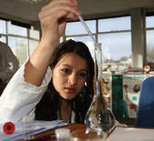
7)IONIC EQUILIBRIA
7.1: Acids and bases
7.2: Acid-base titration
Quantitative analysis of the concentration of an unknown acid or base solution. It makes use of the neutralization reaction that occurs between acids and bases and the knowledge of how acids and bases will react if their formulas are known and what kind of suitable indicator can be used.

Slide 10
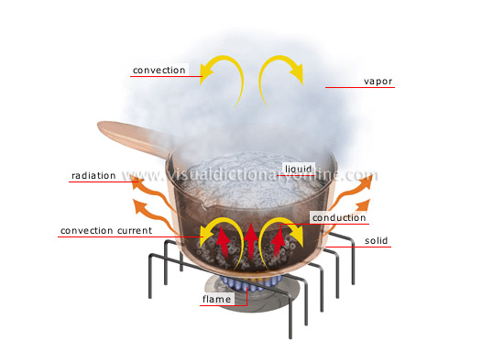
8)THERMOCHEMISTRY
8.1: Concept of enthalpy
8.2: Calorimeter
8.3: Hess’s law
8.4: Born-Haber cycle
Thermochemistry focuses on these energy changes, particularly on the system’s energy exchange with its surroundings. The subject commonly includes calculations heat change in calorimeter, Hess's Law and Born-Haber cycle.

Slide 11
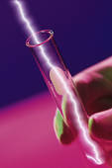
9)ELECTROCHEMISTRY
9.1: Galvanic cell
9.2: Nernst equation
9.3: Electrolytic cell
Electrochemistry deals with situations where oxidation and reduction reactions are separated in space or time, connected by an external electric circuit.

Slide 12
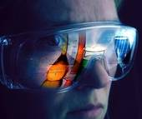
10)REACTION KINETIC
10.1: Reaction rate
10.2: Collision theory and transition state theory
10.3: Factors affecting reaction rate
Is a study of rates of chemical processes. Chemical kinetics includes investigations of how different experimental conditions can influence the speed of a chemical reaction .We will learn in detail on how to use differential rate equation, rate law and integrated rate equation for zero, first and second order of reaction.

Slide 13
11)ORGANIC CHEMISTRY
11.1: Introduction
11.2: Molecular and structural formulae
11.3: Functional group and homologous series
11.4: Isomerism
Organic chemistry is the study of carbon, its compounds, and their properties. These compounds. These compounds may also contain any number of other elements, including hydrogen, nitrogen, oxygen, halogens as well as phosphorus and sulfur.

Slide 14
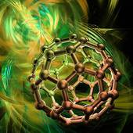
HYDROCARBON
12.1: Alkanes
12.2: Alkenes
12.3: Introduction to aromatic compounds
Hydrocarbon is an organic compound consisting entirely of hydrogen and carbon.
The majority of hydrocarbons found naturally occur in crude oil . They are currently the main source of the world’s electric energy and heat energy because they produce large amounts of heat when burned.

Slide 15
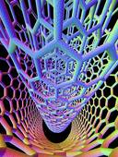
POLYMER
A polymer is a macromolecule composed of repeating structural units. In class we will discuss the natural polymer and explain the preparation of synthetic polymer through condensation and addition polymerization..

