Slide 1
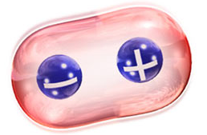
Bond polarity and dipole moment
Polarity of molecules

Slide 2
Learning Outcomes
At the end of the lesson the students should be able to:
(d) Explain bond dipole and dipole moment.
(e) Deduce the polarity of molecules based on the shapes and resultant bond dipole.

Slide 3
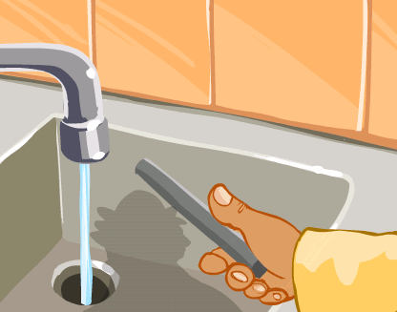
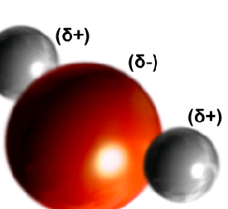
When a negatively charged rod is brought close to a thin stream of water, deflection occurs.

Slide 4
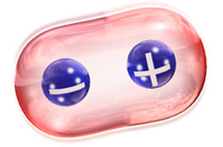
Polar bond
A bond between atoms of different electronegativities in which the distribution of the density of the bonding electron pair is asymmetrical.

Slide 5
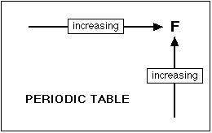
Patterns of electronegativity in the Periodic Table
The most electronegative element is fluorine.
Electronegativity always increase towards fluorine in the Periodic Table.

Slide 6
Polar molecule
A dipole molecule in which the positive and negative pole can be distinguished (because of the separation of the charge).
Example:
δ− δ+ δ−
O = C = O polar or nonpolar?

Slide 7
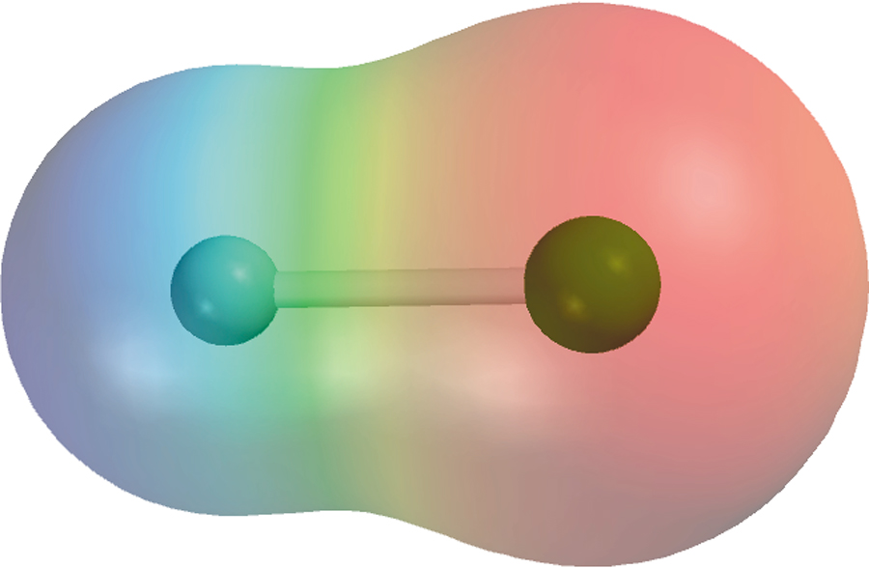
Polar Molecules
electron rich
region
electron poor
region
H
F
δ+
δ−

Slide 8
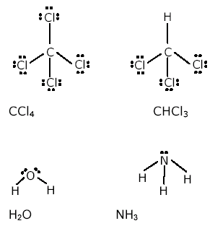
Answer:
polar molecules: H₂O, NH₃, CHCl₃
non-polar molecule: CCl₄

